Slide 1
MODULE 2
MULTILAYER PERCEPTRONS

Slide 2
agenda
INTRODUCTION
BATCH LEARNING ON-LINE LEARNING
BACKPROPORTION ALGORITHM
XOR PROBLEM
HEURISTIC APPROACH FOR BA

Slide 3
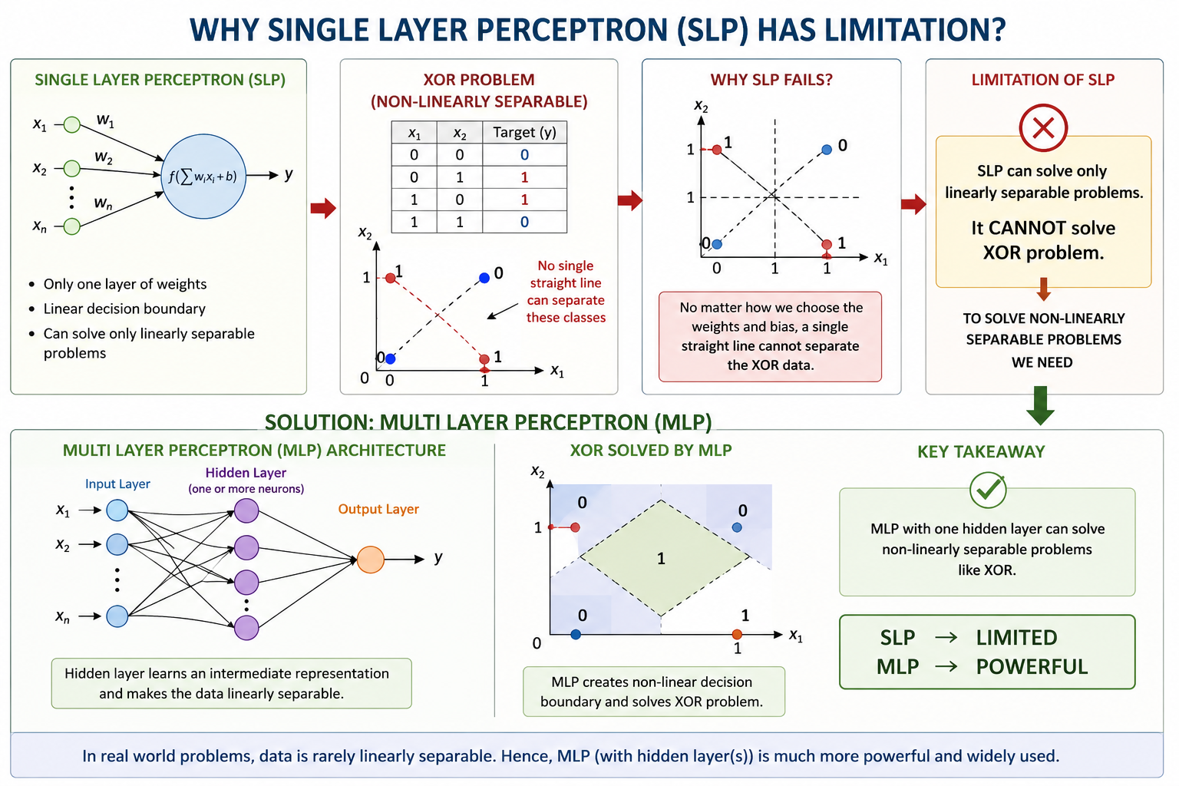

Slide 4
Single Layer Perceptron
↓
Cannot solve XOR
↓
Need Hidden Layer
↓
Multilayer Perceptron

Slide 5
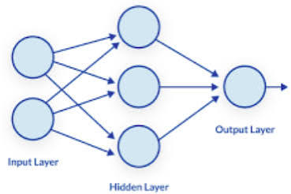
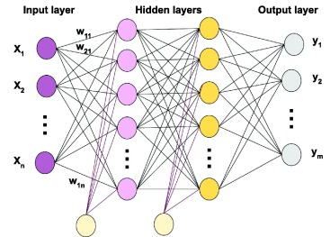
MLP Architecture
A multilayer perceptron (MLP) is a feedforward artificial neural network consisting of one input layer, one or more hidden layers, and one output layer.
MLP can learn non-linear relationships, making it suitable for solving complex problems such as the XOR problem, image classification, speech recognition, and many other real-world tasks.

Slide 6
COMPONENTS OF MLP
INPUT LAYER:
Purpose
Receives the input features from the dataset.
Does not perform any computation.
Simply passes the input values to the hidden layer.
Example
For student data
Age
CGPA
Attendance
↓
Input layer
Number of neurons: Number of input neurons =Number of features
Example
5 features
↓
5 input neurons

Slide 7
COMPONENTS OF MLP
2)HIDDEN LAYER:
This is the heart of the MLP.
Purpose:
Learns hidden patterns from the input data.
Performs mathematical computations.
Extracts useful features.
Enables learning of complex and non-linear relationships.

Slide 8
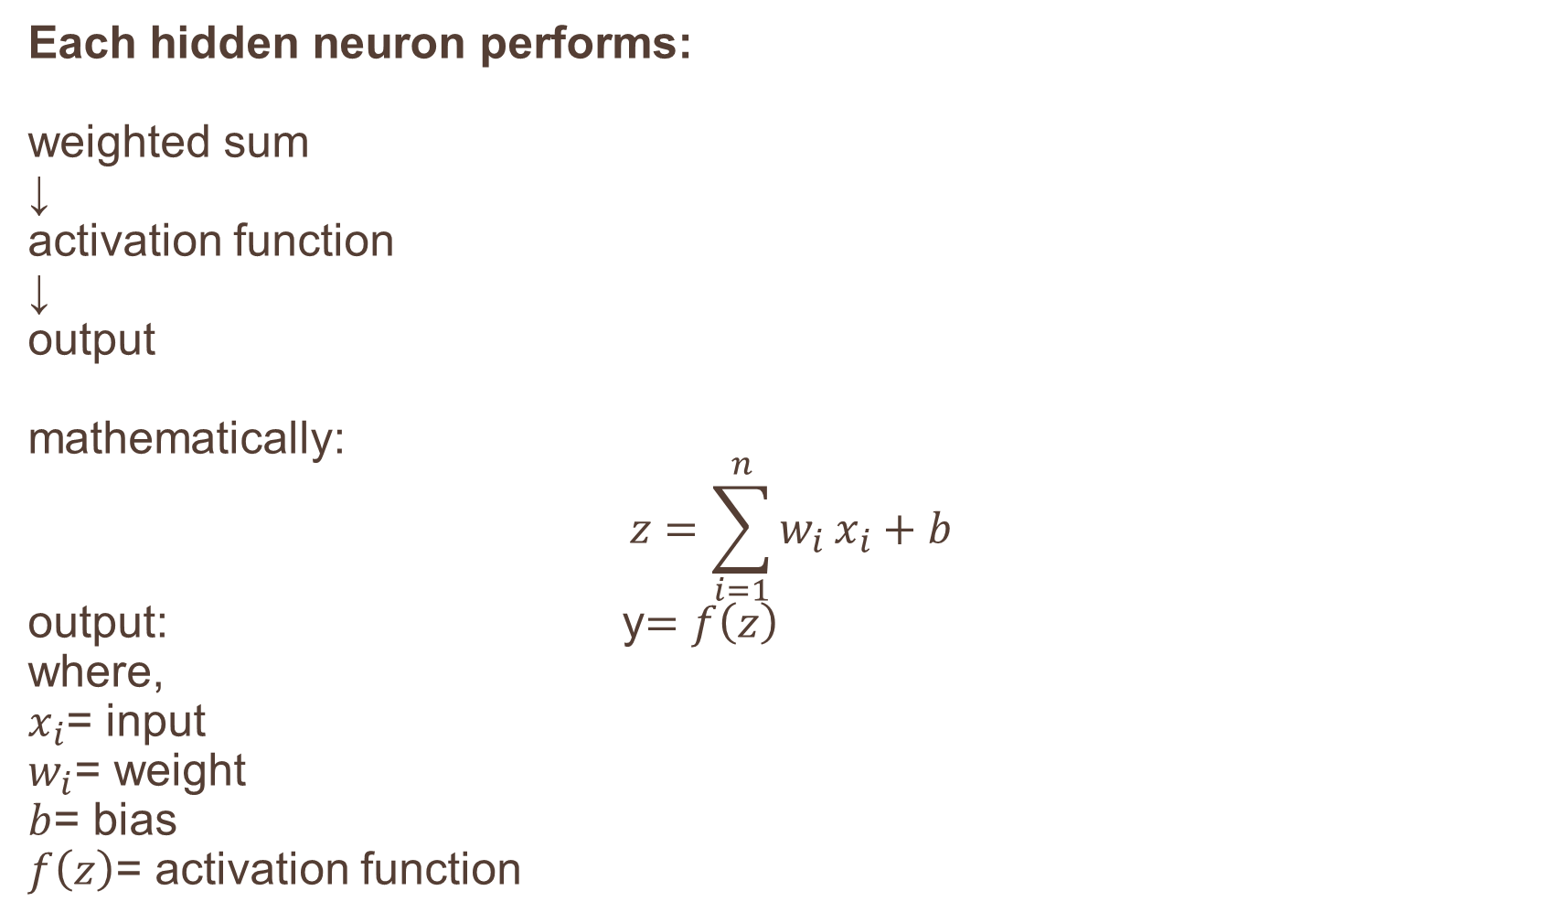
Each hidden neuron performs: weighted sum
↓ activation function
↓ output mathematically:
$$z=\sum_{i=1}^{n}{w_{i}}x_{i}+b$$ output: y$=f\left(z\right)$ where,
$x_{i}$= input
$w_{i}$= weight
$b$= bias
$f\left(z\right)$= activation function

Slide 9
WHY HIDDEN LAYER IS NEEDED?
Without a hidden layer
Only Linear Decision Boundary
With hidden layer
Complex Decision Boundary
↓
Non-linear Learning
↓
Can solve XOR
The hidden layer transforms the input data into a new representation where complex patterns become easier to classify.

Slide 10
COMPONENTS OF MLP
3)OUTPUT LAYER:
Purpose:
Produces the final prediction.
Examples:
BINARY CLASSIFICATION | MULTI-CLASS | REGRESSION
O/p: 0 or 1 | O/p: apple mango berry | O/p: House price Temperature Stock market

Slide 11
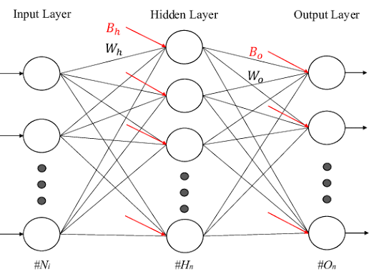
CONNECTIONS BETWEEN THE LAYERS
Every neuron in one layer is connected to every neuron in the next layer
Basic type of Artificial neural network
Hence MLP is called a Fully connected feedforward network (DENSE LAYERS)
Each connection has:
Weight
Bias
Activation

Slide 12
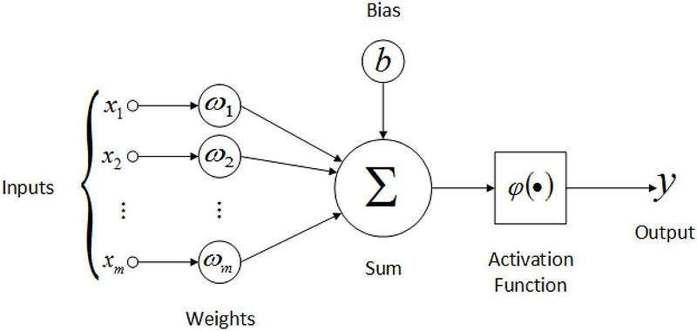
FORWARD PROPOGATION
The data always moves in one direction
No feedback connections
Hence it is called
Feedforward Neural Network
Forward propagation is the process of computing the output of a neural network by passing the input data layer by layer in the forward direction.

Slide 13
ACTIVATION FUNCTION
Activation functions introduce non-linearity.
Common activation functions for MLP
Sigmoid
Tanh (hidden layer)
ReLu
SoftMax (output layer)

Slide 14
LEARNING PROCESS for FORWARD PROPOGATION
Input Features
│
Input Layer
│
Weighted Sum (Wx + b)
│
Activation Function
│
Hidden Layer Output
│
Repeat for Next Hidden Layer (if any)
│
Output Layer
│
Predicted Output (ŷ)
EXAMPLE:
Consider an MLP with:
2 input neurons
2 hidden neurons
1 output neuron

Slide 15
SOLVING EXAMPLES:
x1=1 x2=0
(Input → hidden)
Wx1h1= 0.20 Wx1h2= 0.40
Wx2h1= 0.30 Wx2h2= 0.10 bh = 0.10
(hidden → output)
Wh1y= 0.50 Wh2y = 0.60 b0 = 0.20
h1
x1
y
x2
h2

Slide 16
Suppose the actual (target) output is 1, but our network predicted 0.703
What should the network do?
Increase the output
Change the weights
Reduce the error

Slide 17
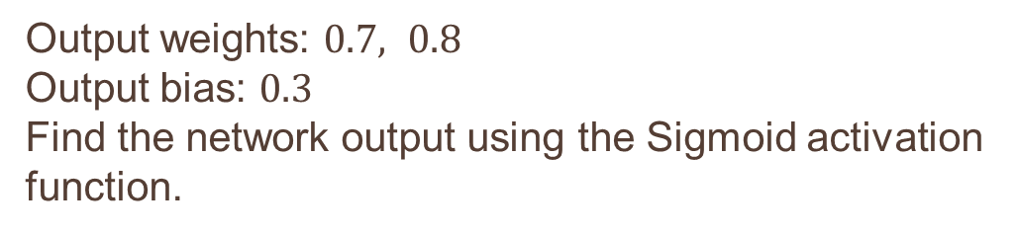
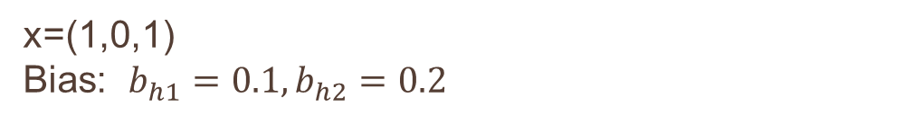
NUMERICALS ON FORWARD PROPOGATION
1. Forward Propagation with 3 Inputs 2 hidden &1 output neuron
x=(1,0,1)
Bias: $b_{h1}=0.1, b_{h2}=0.2$
Output weights: $0.7, 0.8$
Output bias: $0.3$
Find the network output using the Sigmoid activation function.
Input→Hidden | Weights
x1→h1 | 0.3
x2→h1 | 0.4
x3→h1 | 0.2
x1→h2 | 0.5
x2→h2 | 0.1
x3→h2 | 0.6

Slide 18
BATCH LEARNING
A neural network can learn in the same way.
Instead of updating its weights after every training example, it waits until it has seen the entire dataset and then updates the weights once.
This is called batch learn Training Data
Sample 1
Sample 2
Sample 3
Sample 4
...
Sample N
↓
Compute error for each sample
↓
Accumulate all weight changes
↓
Update weights ONCE
↓
Next Epoch.
The network waits until every training sample has been processed before updating the weights

Slide 19
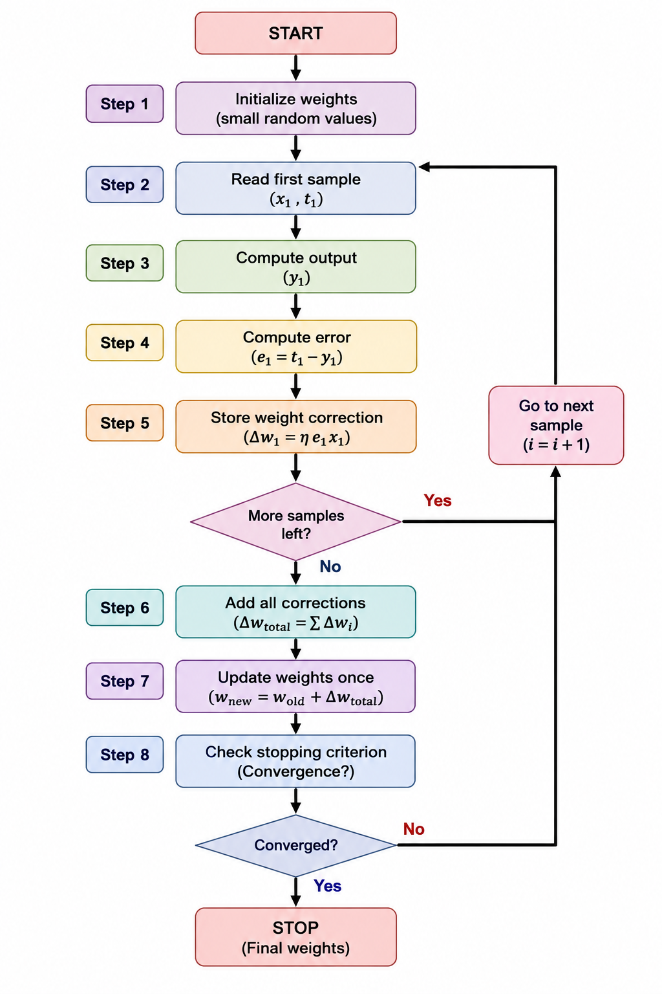
Algorithm

Slide 20
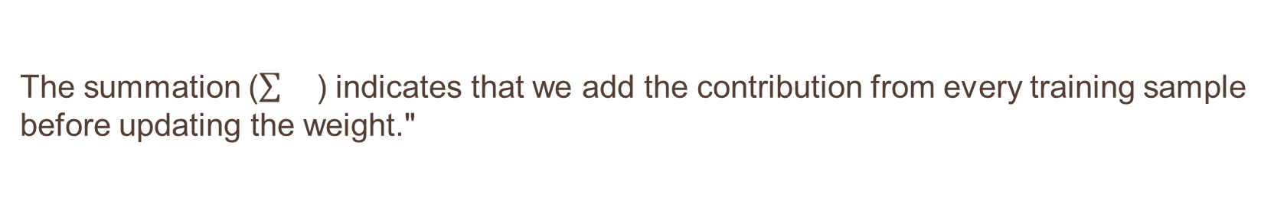
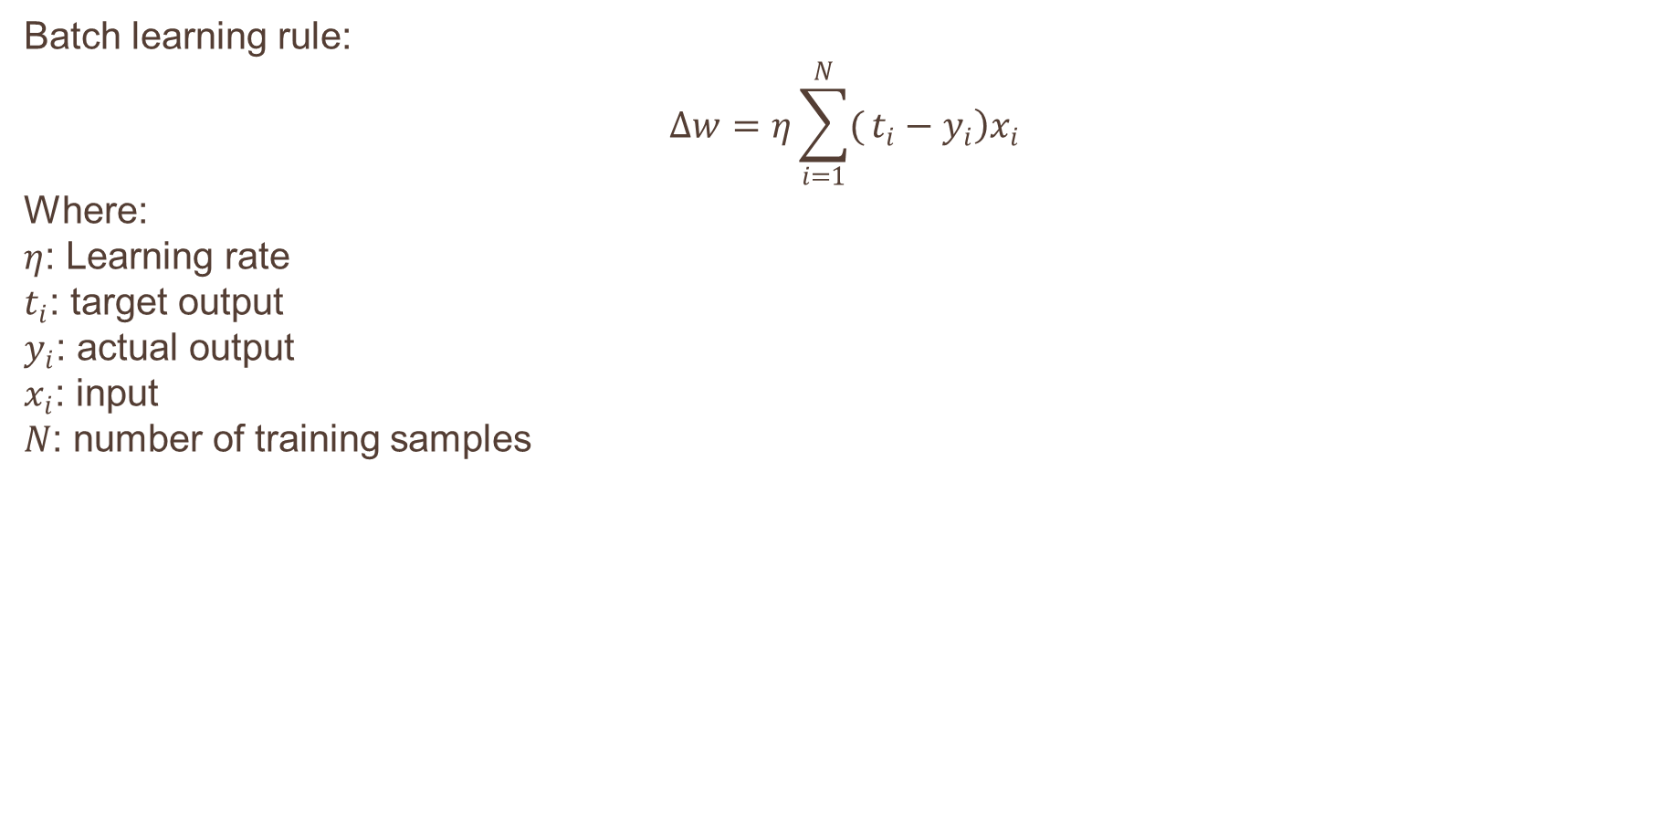
Mathematical Representation
Batch learning rule:
$$Δw=η\sum_{i=1}^{N}{(}\left.t_{i}−y_{i}\right)x_{i}$$
Where:
$η$: Learning rate
$t_{i}$: target output
$y_{i}$: actual output
$x_{i}$: input
$N$: number of training samples
The summation () indicates that we add the contribution from every training sample before updating the weight."

Slide 21
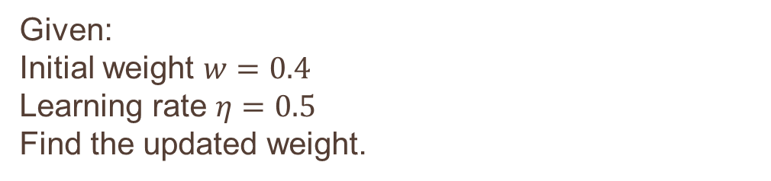
Given:
Learning rate = 0.1
Initial weight = 0.5
FIND THE UPDATED WEIGHT
Sample | x | Target | Output
1 | 1 | 1 | 0
2 | 0 | 0 | 1
3 | 1 | 1 | 1
Given:
Initial weight $w=0.4$
Learning rate $η=0.5$
Find the updated weight.
Sample | x | Target | Output
1 | 2 | 1 | 0
2 | 1 | 0 | 1
3 | 3 | 1 | 0

Slide 22
Batch Learning processes the entire training dataset before updating weights.
Errors from all samples are accumulated.
A single weight update is made at the end of each epoch.
It provides stable and smooth convergence, but each update is computationally more expensive than On-line Learning.
It is suitable when the dataset can fit into memory and when stable optimization is preferred.

Slide 23
ON-LINE LEARNING
Online learning is a learning method in which the neural network updates its weights immediately after processing each training sample instead of waiting for the complete dataset.
Sample 1
↓
Output
↓
Error
↓
Update weights
↓
Sample 2
↓
Output
↓
Update weights
↓
Sample 3
↓
Output
↓
Update weights
↓
Continue...

Slide 24
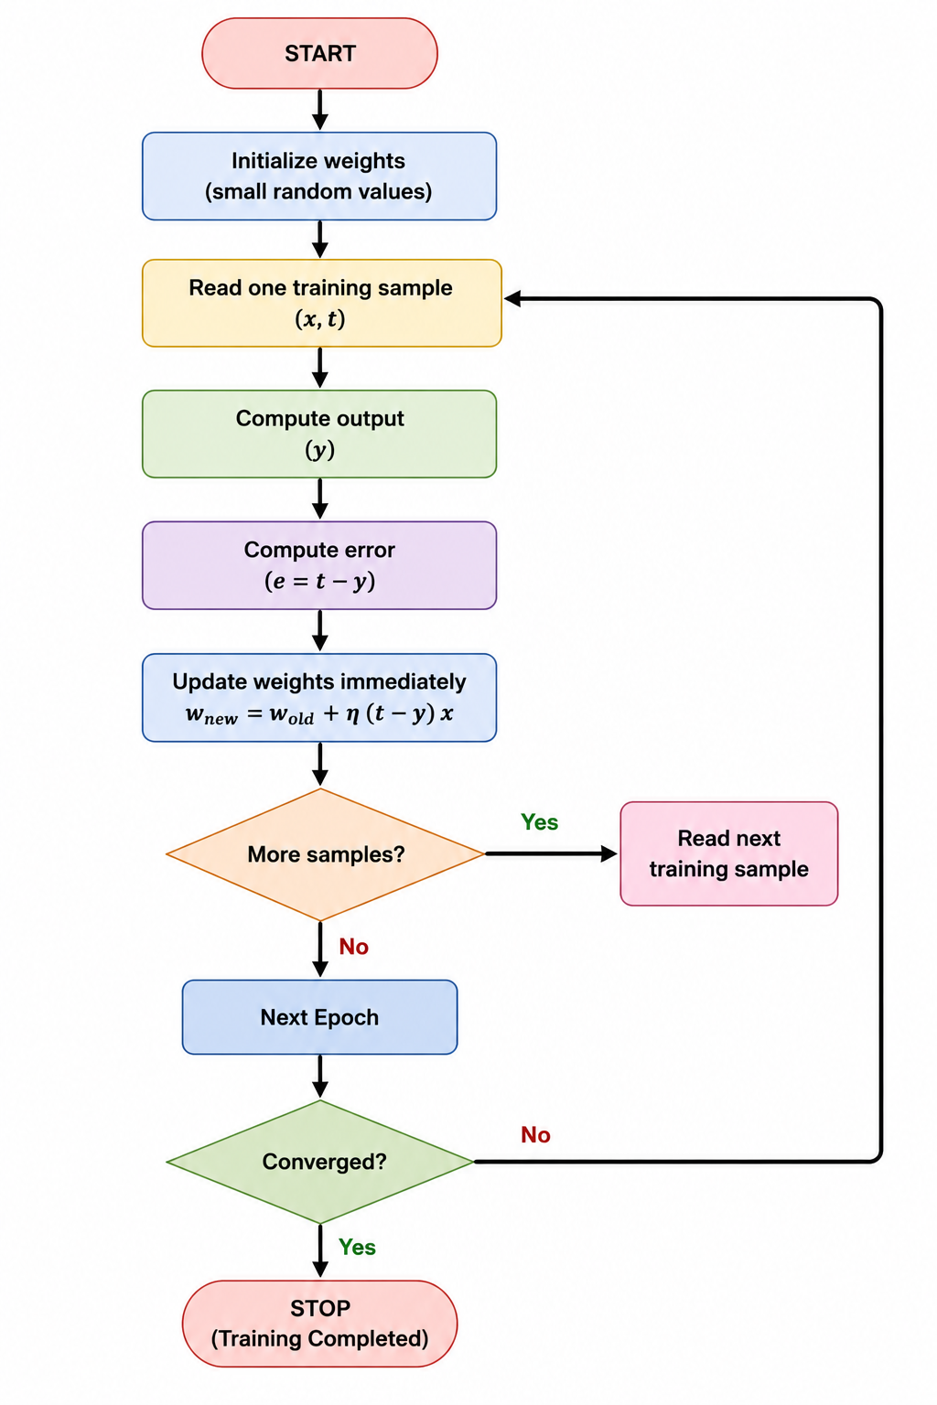
Algorithm

Slide 25
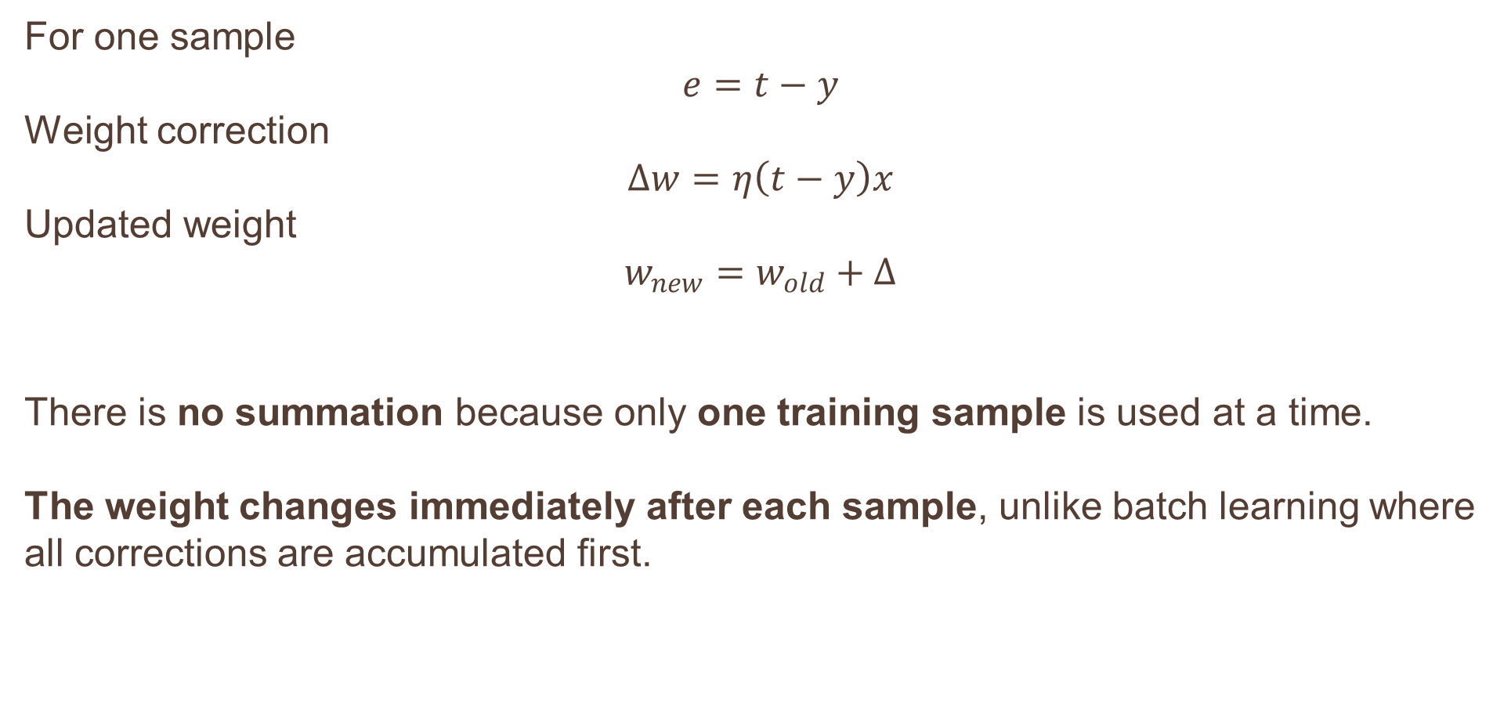
MATHEMATICAL REPRESENTATION
For one sample
$$e=t−y$$
Weight correction
$$Δw=η\left(t−y\right)x$$
Updated weight
$$w_{new}=w_{old}+Δ$$
There is no summation because only one training sample is used at a time.
The weight changes immediately after each sample, unlike batch learning where all corrections are accumulated first.

Slide 26
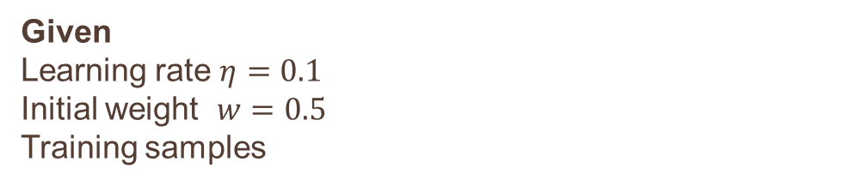
Given
Learning rate $η=0.1$
Initial weight $w=0.5$
Training samples
Sample | x | t | y
1 | 1 | 1 | 0
2 | 0 | 0 | 1
3 | 1 | 1 | 1

Slide 27
Batch Learning = "Study first, write exam later"
Collect everything first → Learn later
Online Learning = "Learn while doing"
Receive one sample → Learn immediately
Examples:
Semester exam evaluation
Census analysis
Annual company reports
Examples:
Google Maps
UPI fraud detection
Stock trading
Recommendation systems
Batch learning updates after a group of examples, whereas online learning updates continuously after each example.

Slide 28
BATCH VS ON-LINE
Features | Batch Learning | On-line Learning
Weight update | After all samples | After every sample
Memory | High | Low
Speed of updates | Slow | Fast
Convergence | Smooth and stable | Faster but can oscillate
Suitable for | Small/medium datasets | Large or streaming datasets
Computation | Uses entire dataset | Uses one sample at a time

Slide 29
"If Batch Learning updates too slowly and Online Learning updates too frequently, can we find a balance between the two?” Mini-batch Learning

Slide 30
BACKPROPAGATION ALGORITHM
A neural network also makes mistakes.
It predicts an output, compares it with the expected output, identifies the error, and adjusts its weights so that the next prediction is better.
This correction process is called BACKPROPAGATION.
Input
↓
Forward Propagation
↓
Predicted Output
↓
Compare with Target
↓
Calculate Error
↓
Backpropagation
↓
Update Weights
↓
Repeat

Slide 31
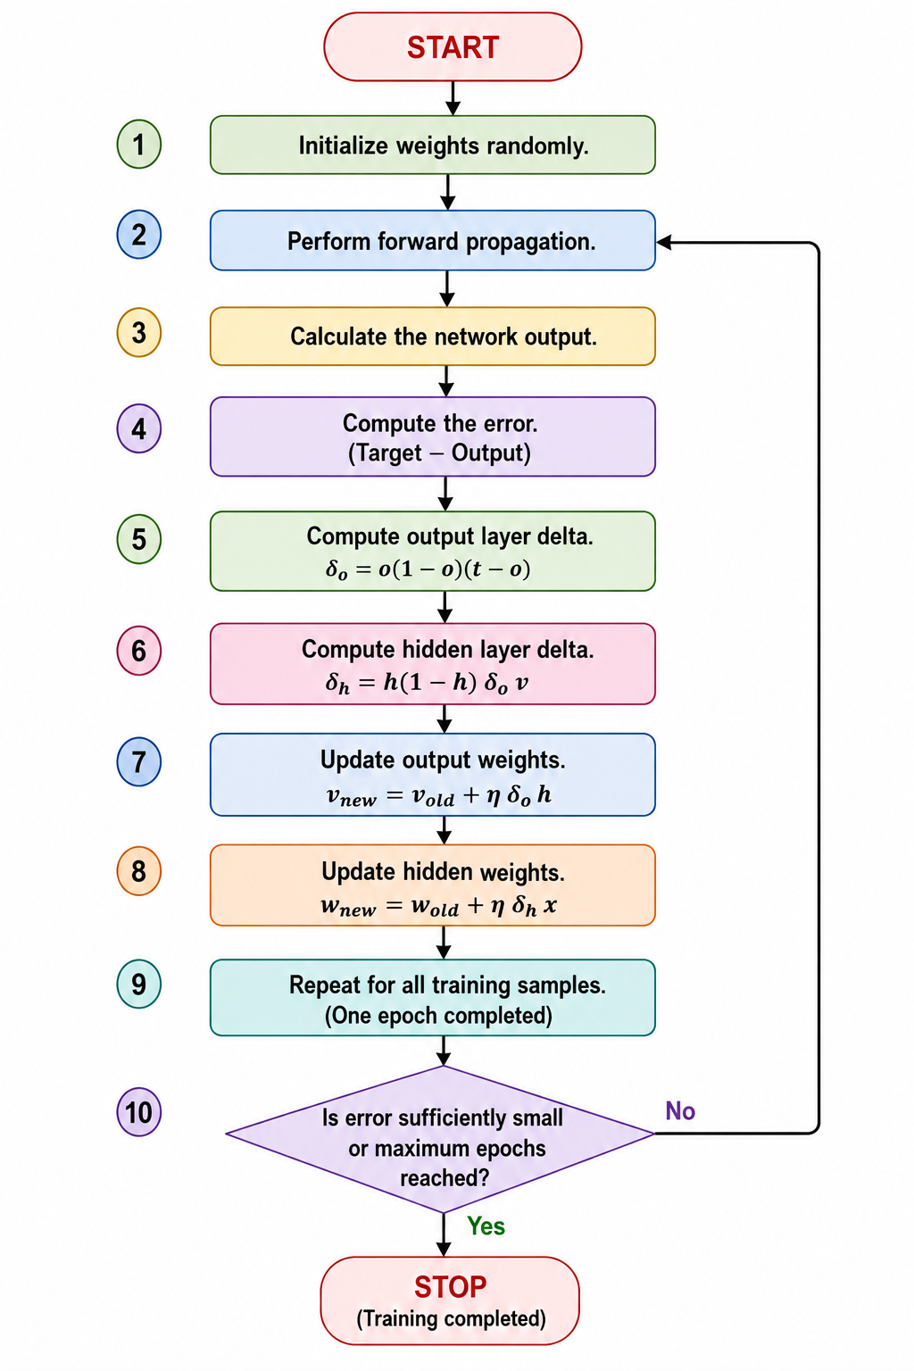
Algorithm
Delta (δ) represents the error signal of a neuron
It tells us how much that neuron contributed to the final error and how much its weights should be adjusted.
Delta tells us:
How much error exists at a neuron.
In which direction the weights should be changed.
The magnitude of the weight update.

Slide 32
Forward Pass
Input
│
▼
Hidden Layer
│
▼
Output Layer
│
▼
Prediction
──────────────
Backward Pass
Prediction Error
│
▼
Output Delta (δo)
│
▼
Hidden Delta (δh)
│
▼
Weight Update

Slide 33
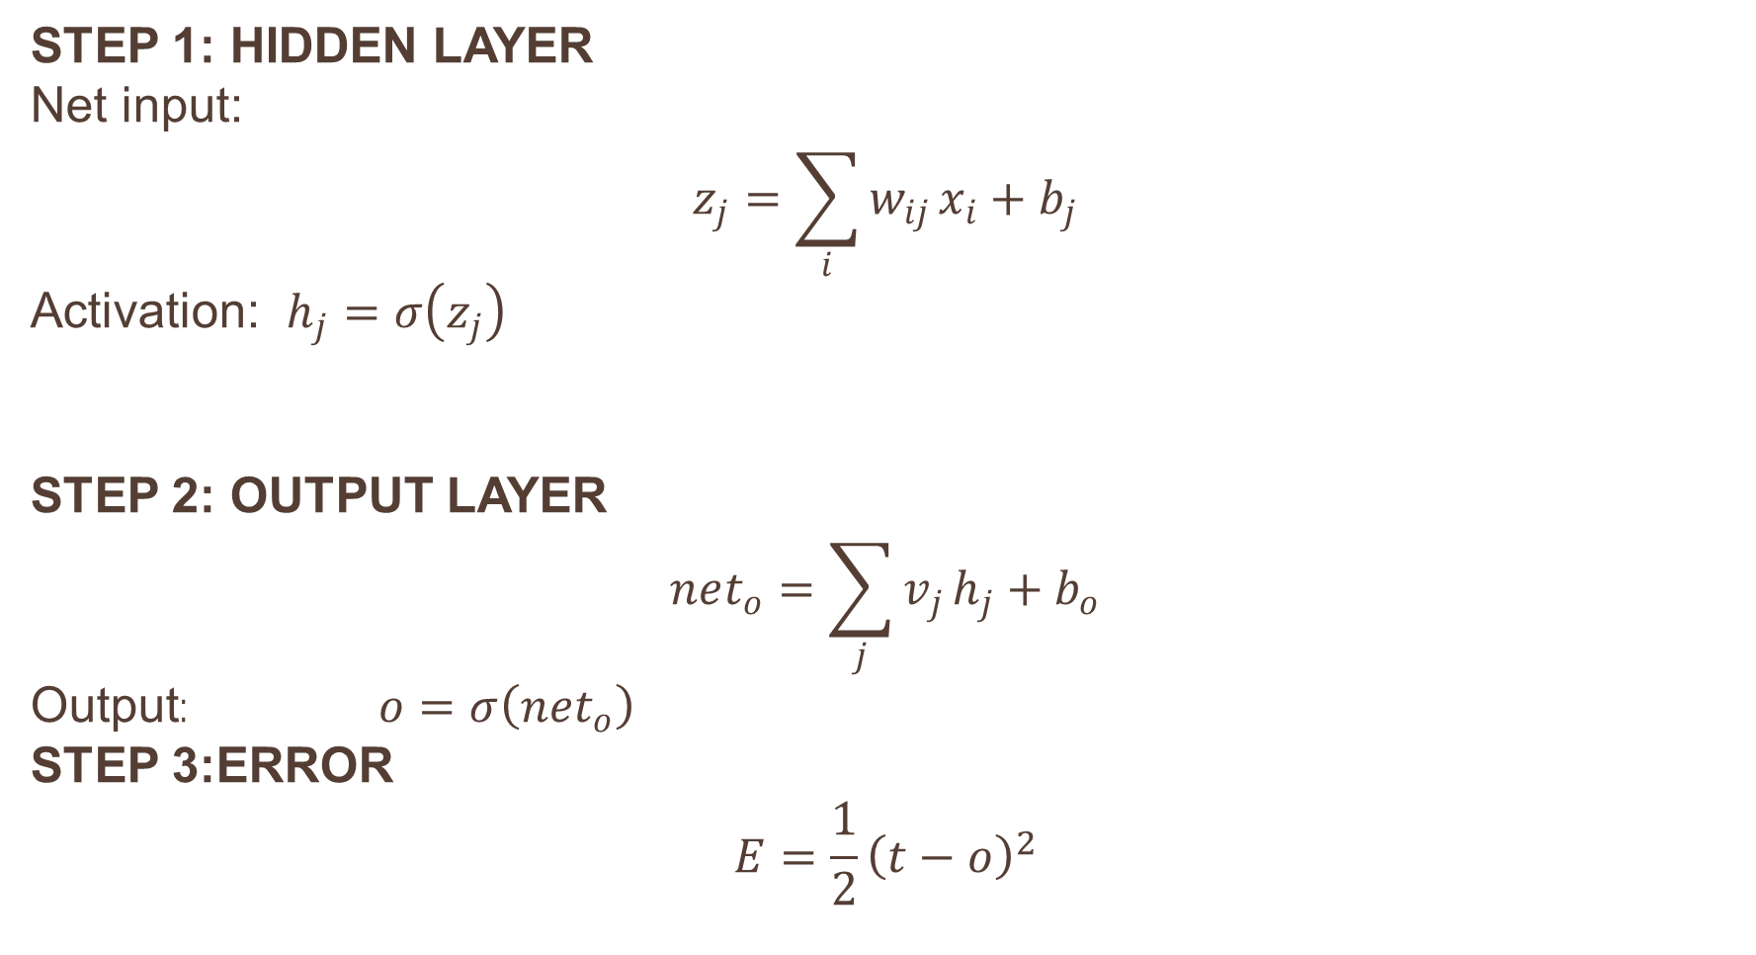
MATHEMATICAL EQUATIONS
Step 1: Hidden Layer
Net input:
$$z_{j}=\sum_{i}{w_{ij}}x_{i}+b_{j}$$
Activation: $h_{j}=σ\left(z_{j}\right)$
Step 2: Output Layer
$$net_{o}=\sum_{j}{v_{j}}h_{j}+b_{o}$$
Output: $o=σ\left(net_{o}\right)$
STEP 3:ERROR
$$E=\frac{1}{2}{\left(t−o\right)}^{2}$$

Slide 34
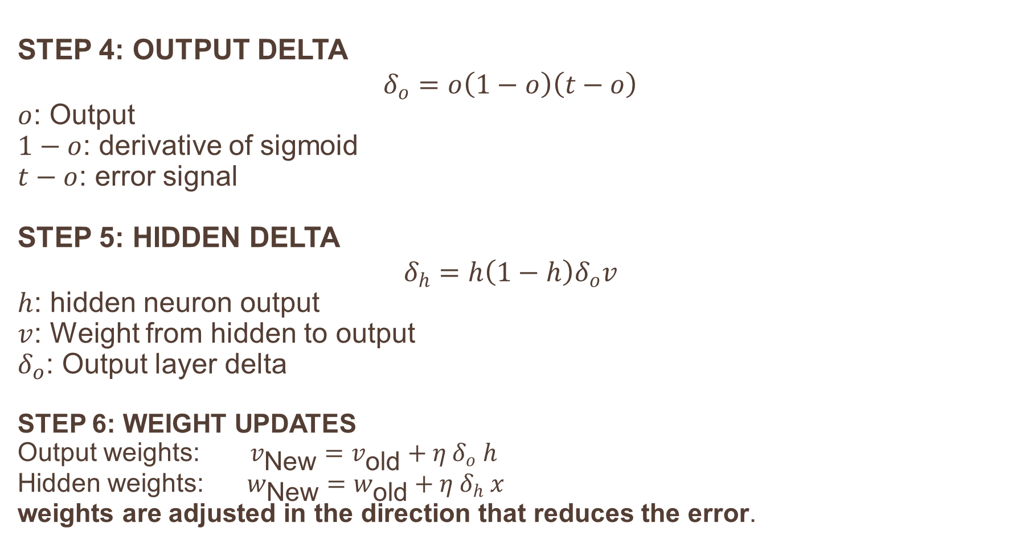
MATHEMATICAL EQUATIONS
STEP 4: OUTPUT DELTA
$$δ_{o}=o\left(1−o\right)\left(t−o\right)$$
$o$: Output
$1−o$: derivative of sigmoid
$t−o$: error signal
STEP 5: HIDDEN DELTA
$$δ_{h}=h\left(1−h\right)δ_{o}v$$
$h$: hidden neuron output
$v$: Weight from hidden to output
$δ_{o}$: Output layer delta
STEP 6: WEIGHT UPDATES
Output weights: $v_{\text{New}}=v_{\text{old}}+η δ_{o} h$
Hidden weights: $w_{\text{New}}=w_{\text{old}}+η δ_{h} x$
weights are adjusted in the direction that reduces the error.

Slide 35
Advantages | Limitations
Learns non-linear relationships | Computationally intensive
Supports multiple hidden layers, | Can converge slowly, requiring many epochs to minimize the error.
high prediction accuracy | Requires differentiable activation functions (e.g., Sigmoid, Tanh)
Forward propagation answers the question: 'what is the network's prediction?’
Backpropagation answers: 'how should the network change its weights so the next prediction is better?’
Together, they form the learning cycle of a neural network.

Slide 36
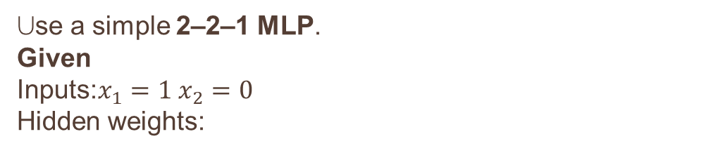
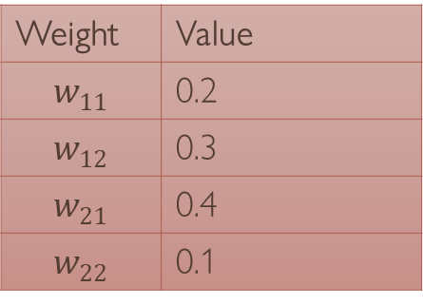
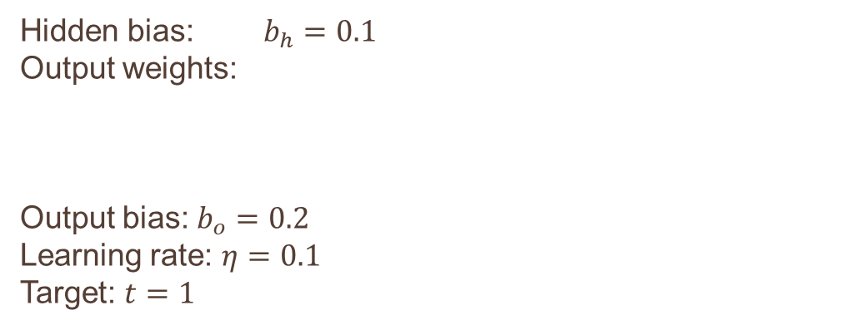
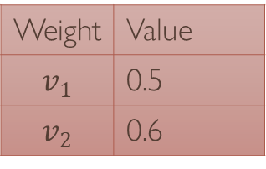
NUMERICAL
Use a simple 2–2–1 MLP.
Given
Inputs:$x_{1}=1 x_{2}=0$
Hidden weights:
Hidden bias: $b_{h}=0.1$
Output weights:
Output bias: $b_{o}=0.2$
Learning rate: $η=0.1$
Target: $t=1$
Weight | Value
$$v_{1}$$ | 0.5
$$v_{2}$$ | 0.6
Weight | Value
$$w_{11}$$ | 0.2
$$w_{12}$$ | 0.3
$$w_{21}$$ | 0.4
$$w_{22}$$ | 0.1
Compute:
Hidden outputs
Final output
Error
Output delta
Hidden deltas
Updated output weights
Updated hidden weights

Slide 37
XOR PROBLEM
An MLP introduces one or more hidden layers.
The hidden neurons transform the input space into a new representation where the classes become linearly separable.
Instead of one straight line, the hidden neurons combine to create multiple decision boundaries, enabling the network to separate XOR correctly.

Slide 38
ARCHITECTURE OF XOR
Typically, 2 input neurons, 2 hidden neurons, and 1 output neuron are sufficient to solve the XOR problem, if we want we can increase the hidden layer neurons
X1
X2
h1
h2
o

Slide 39
Original XOR Data
Hidden Layer
Feature Transformation
New Representation
Decision Boundary
XOR Solved

Slide 40
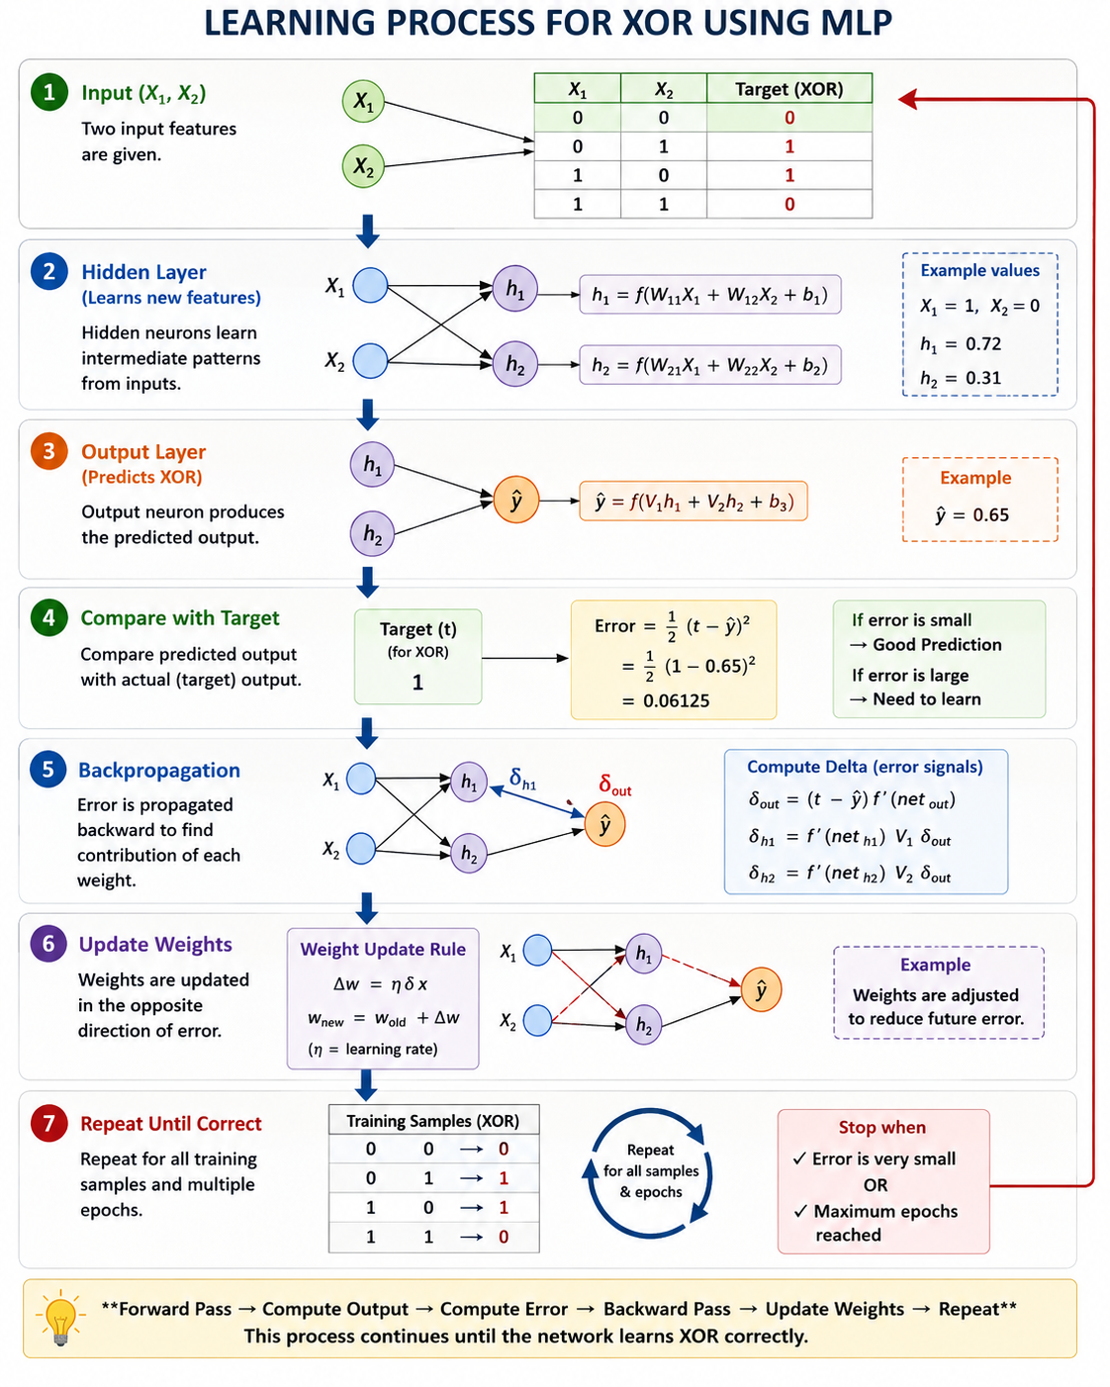

Slide 41
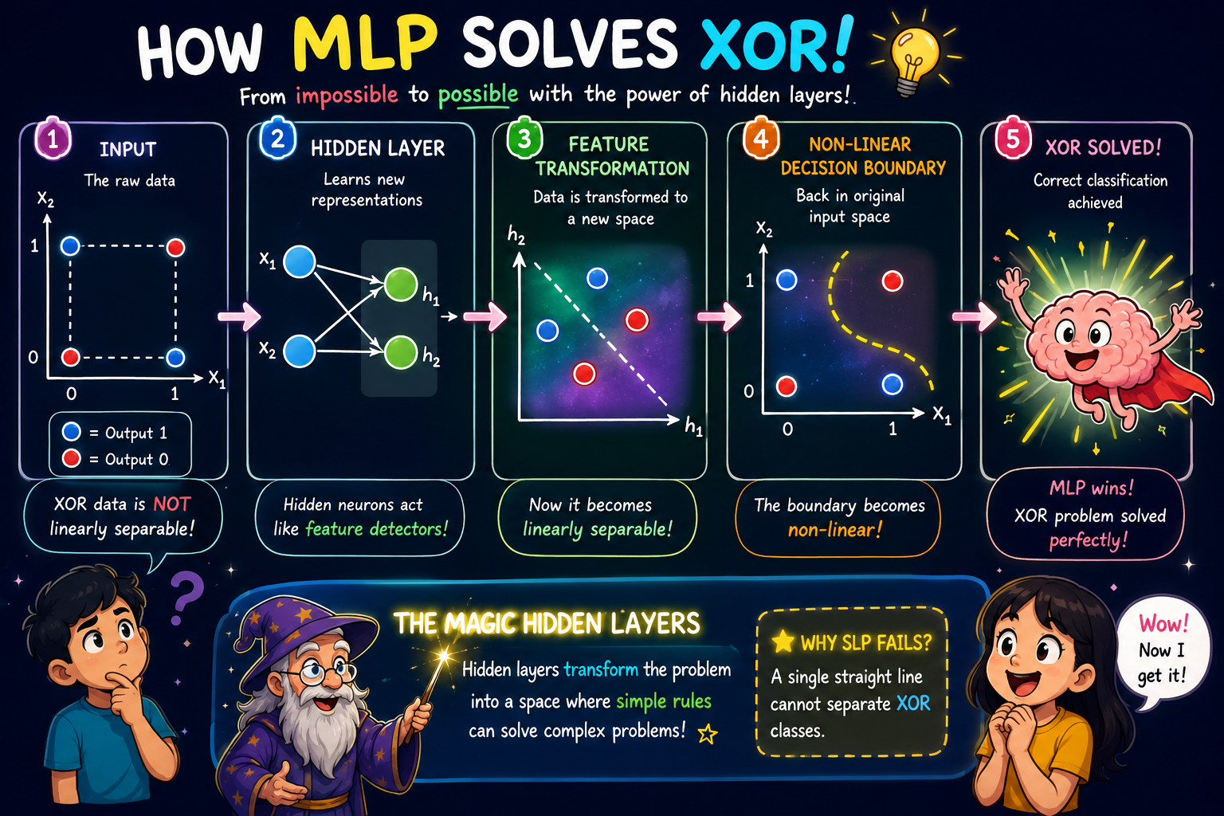

Slide 42
Heuristics for Making Backpropagation Perform Better
Heuristics are practical techniques or rules of thumb used to improve the speed, stability and quality of neural network training
Backpropagation tells us HOW to learn
Heuristics tell us HOW TO MAKE THAT LEARNING BETTER

Slide 43
LEARNING RATE
MOMENTUM
WEIGHT INITIALIZATION
INPUT NORMALIZATION
ACTIVATION FUNCTION
MINI-BATCH TRAINING
EARLY STOPPING

Slide 44
Heuristic 1 – Learning Rate
Learning rate η controls the size of the weight update.
wnew​=wold​+ηδx
Small η → slow learning
Large η → unstable learning
Suitable η → faster and stable learning
Error
Error
Error
Epoch
Epoch
Epoch
Very Slow
Oscillation
Smooth

Slide 45
Heuristic 2 – Momentum
Momentum uses information from the previous weight update to influence the current update.
Δw(t)=ηδx+αΔw(t−1)
η = learning rate
α = momentum coefficient
Δw(t−1) = previous weight change
Momentum helps the network move faster in the correct direction and reduces unnecessary oscillations.

Slide 46
Heuristic 3 – Weight Initialization
If all neurons start with identical weights, they can learn the same thing.
Therefore, weights are generally initialized with suitable small random values or using modern initialization schemes.
Modern initialization schemes:
Xavier/glorot initialization
He initialization
Heuristic 4 & 5 Common approach
H-4: Cleaning the data (normalizing data)
H-5: Activation function (Choose according to problem)

Slide 47
Heuristic 6 – Mini-Batch Learning
Batch Learning
Stable but computationally expensive
Online Learning
Fast updates but noisy
Mini-Batch
Balance between the two
Modern neural networks commonly use mini-batch training because it provides a practical balance between computational efficiency and stable learning

Slide 48
Heuristic 7 – Early Stopping
TRAINING
MONITOR VALIDATING ERRORS
NOT IMPROVING
STOP

Slide 49
MAKE BACKPROPAGATION BETTER
Learning Rate
Momentum
Initialization
Stable Step
Faster Path
Good Start
Normalization
Activation
Mini-Batch
Better Scale
Efficient Gradients
Better Training
Early Stopping
Avoid Overfitting

Slide 50
BACKPROPAGATION & DIFFERENTIATION
WHY WE NEED DIFFERENTIATION IN BP?
To find how much each weight contributed to the error and adjust the weights to reduce the error.
we need the derivative of the error with respect to each weight.
the basic idea is:
wnew​=wold​−η(∂E/∂w)​
where:
w = weight
E = error/loss
η = learning rate
∂E/∂w​ = gradient
Differentiation → Gradient → Weight Update → Lower ErroR

Slide 51
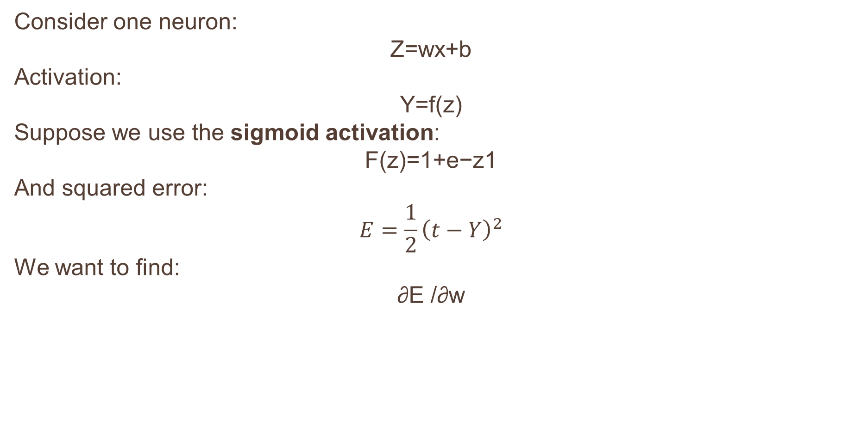
SIMPLE NEURON
Consider one neuron:
Z=wx+b
Activation:
Y=f(z)
Suppose we use the sigmoid activation:
F(z)=1+e−z1​
And squared error:
$$E=\frac{1}{2}{\left(t−Y\right)}^{2}$$
We want to find:
∂E /∂w​

Slide 52
CHAIN RULE
The error depends on y, y depends on z, and z depends on w.
weight→ z→ y→ E
Using the chain rule:
∂E/∂w = ∂E/∂y​ ∂y/∂z ​∂z/∂w​​
This is essentially what backpropagation does
Backpropagation is basically the chain rule applied backward through the neural network.

Slide 53
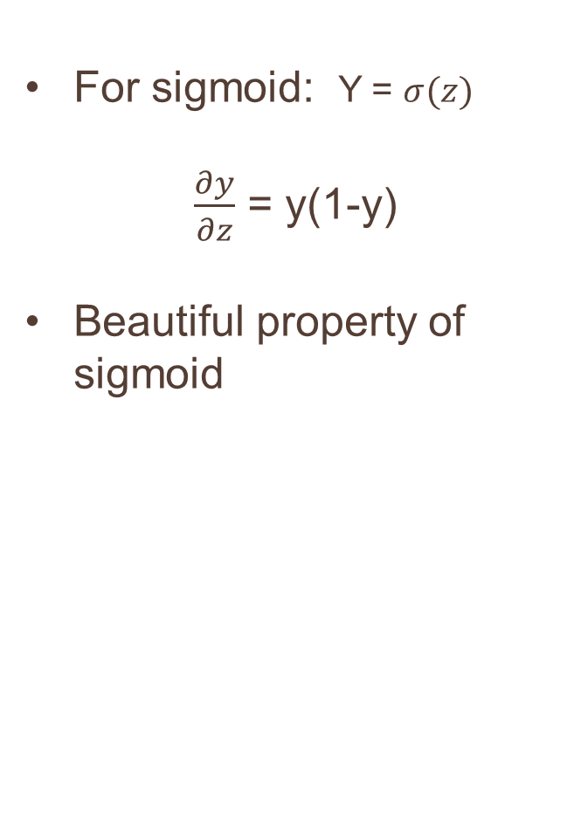
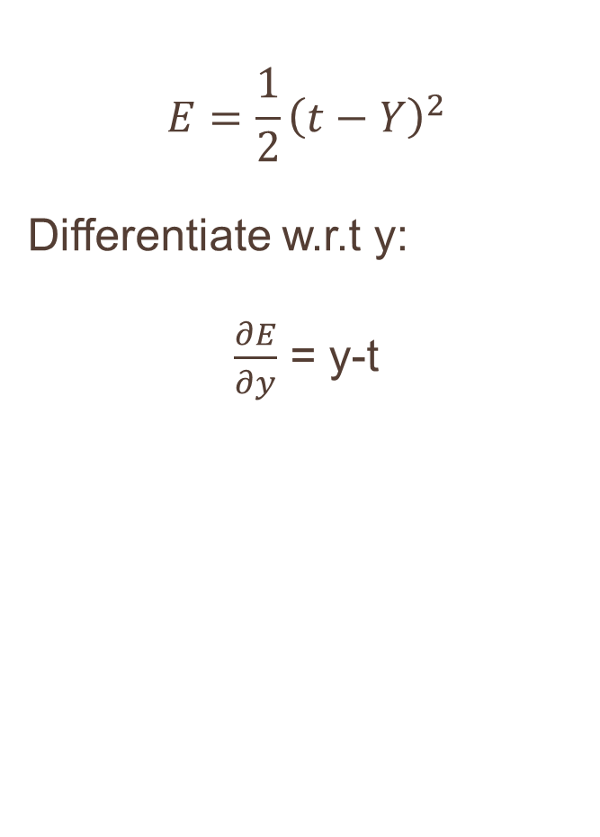
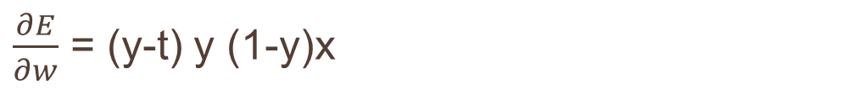
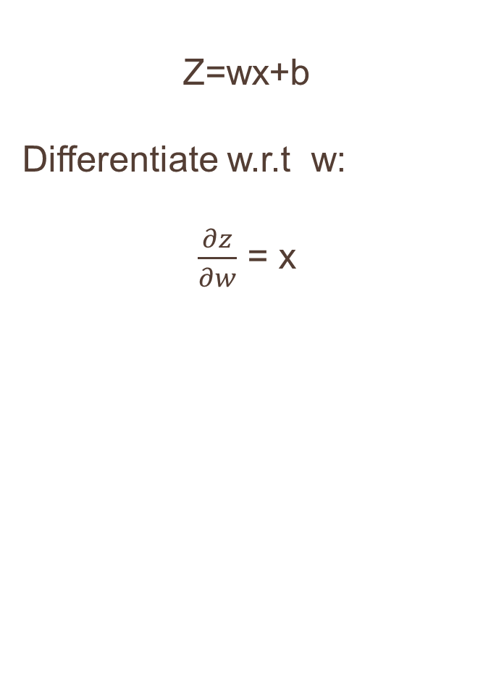
ERROR DERIVATIVES
ACTIVATION DERIVATIVE
$$E=\frac{1}{2}{\left(t−Y\right)}^{2}$$
Differentiate w.r.t y:
$\frac{∂E}{∂y}$ = y-t
For sigmoid: Y = $σ(z)$
$\frac{∂y}{∂z}$ = y(1-y)
Beautiful property of sigmoid
NEURON DERIVATIVE
Z=wx+b
Differentiate w.r.t w:
$\frac{∂z}{∂w}$ = x
COMBINE ALL DERIVATIES
$\frac{∂E}{∂w}$ = (y-t) y (1-y)x

Slide 54




EXTEND TO MLP
Forward direction:
Input→ hidden layer →output → error
Backward direction:
Error→ output layer→ hidden layer→ input
The error is propagated backward using derivatives.
For an output neuron:
For a hidden neuron:
And the weight gradient becomes:
Hence the weight update:

Slide 55
Forward propagation calculates the output.
Loss function calculates how wrong the output is.
Backpropagation calculates how each weight contributed to that error.
Differentiation/chain rule gives us those contributions.
Gradient descent updates the weights.
Concept | Purpose
Differentiation | Calculates rate of change
Backpropagation | Efficiently calculates gradients through all layers
Gradient Descent | Uses gradients to update weights

